Slide 1


Food Processing

Slide 2
Food Processing
Operations by which raw foodstuffs are made suitable for consumption, cooking, or storage.
Food processing generally includes
Basic preparation of foods,
Alteration of a food product into another form (as in making preserves from fruit), a
Preservation and packaging technique

Slide 3
The Role of Food Preservation in Food Safety
The primary goal of food preservation is to extend the shelf life of food products while maintaining their nutritional value, flavor, and quality.
preventing the growth of microorganisms,
inhibiting the activity of enzymes that can lead to spoilage.
reduce food cost,
improve convenience,
lengthen shelf life and reduce food waste.

Slide 4
Processing Methods
Two main categories
Chemical
Physical

Slide 5
Physical preservation
Refrigeration
Drying.
Chemical Processing Methods
Addition of Chemicals
PH Control

Slide 6
pH Control
Almost every food, with the exception of egg whites and soda crackers, has a pH value of less than 7.
Foods can be broadly categorized on the basis of their pH as high acid, acid, medium acid or low acid.

Slide 7
Examples of each category include:
high acid (3.7) : apples, lemons, raspberries
acid (3.7 to 4.6) : oranges, olives, tomatoes (some)
medium acid (4.6 to 5.3) : bread, cheese, carrots
low acid (over 5.3) : meat, fish, most vegetables

Slide 8
Most micro-organisms grow best in the pH range of 6.5 to 7.5.
Yeasts and moulds are capable of growing over a much broader pH range than bacteria.
Few pathogens will grow below pH 4.0. (Lactic acid bacteria)

Slide 9
Physical Processing Methods
Sterilization
Pasteurization
Blanching
Microwaving
Frying
Refrigeration
Freezing
Irradiation
Evaporation
Dehydration
Emulsions
Homogenization
Extrusion

Slide 10
Sterilization
Sterilization destroys all pathogenic and spoilage micro-organisms in foods and inactivates enzymes by heating.
All canned foods are sterilized in a retort (a large pressure cooker).
This process enables food to have a shelf life of more than two years.

Slide 11
Foods that have a pH of more than 4.6, such as meat and most vegetables, must undergo severe heating conditions to destroy all pathogens.
These foods are heated under pressure to 121°C for varying times.

Slide 12
Pasteurization
Pasteurization is the process of heating a food-usually a liquid-to or below its boiling point for a defined period of time.
Ex Pasteurization of milk requires 63 °C and 30 minutes
The purpose of Pasteurization
to destroy all pathogens,
reduce the number of bacteria,
inactivate enzymes and extend the shelf life of a food product.

Slide 13
Foods with a pH of less than 4.6, such as milk and spaghetti sauce, can be pasteurized.
Permanent stability-that is, shelf life of about two years-is obtained with foods that can withstand prolonged heating, such as bottled juices.

Slide 14
Blanching
Blanching is a slight heat treatment, using hot water or steam, that is applied mostly to vegetables before canning or freezing.
Blanching is used before freezing to inactivate enzymes present that cause deteriorative reactions to foods during frozen storage.
These reactions include
colour and texture changes,
off-flavours and
a decrease in nutritional value.

Slide 15
Refrigeration
Refrigerators should be set to below 4°C to control the growth of micro-organisms in foods.
This lowered temperature also reduces the respiration rate of fruits and vegetables, which retards reactions that promote spoilage.

Slide 16
Freezing
While many home freezers are held at -10°C, commercial freezers are under -18°C. At this temperature, the growth of micro-organisms is almost stopped. Deteriorative microbial reactions will still occur, but over a much longer time.
In addition, deteriorative enzymatic reactions will still take place during frozen storage. Uncooked fruits and vegetables must be blanched before freezing to prevent these reactions.

Slide 17
Irradiation
Irradiation is the controversial process of applying low doses of gamma radiation to food products.

Slide 18
Irradiation is generally used for:
prevent sprouting in potatoes and onions;
control insect growth in wheat flour and
reduce the microbial load of ground spices such as cumin, turmeric, coriander etc

Slide 19
Evaporation
Evaporation is the partial removal of water from liquid foods by boiling. When the operation is done under vacuum, boiling is avoided and the food's flavour qualities are retained.
Some of the foods that have undergone evaporation are evaporated milk, tomato paste and juice concentrates.

Slide 20
This process is carried out for three main reasons:
to reduce the weight and, therefore,
reduce storage and transport costs;
to preserve foods by decreasing the water activity and increasing the solids content; and
to provide consumers with convenient foods.

Slide 21
Dehydration
Dehydration-or drying-is the nearly complete removal of water from solid foods.
One of the oldest methods of food preservation, it was traditionally carried out by the sun.
This application is used for the same reasons that liquid foods undergo evaporation-preservation, convenience and cost savings.
Dried soup mixes, dried fruit, powdered milk and spices are just a few examples of dehydrated foods.

Slide 22
DRYING
Drying is the process of removing liquid from solids by evaporation
Spray drying is a method of producing a dry powder from a liquid or slurry by rapidly drying with a hot gas.
APPLICATIONS
1. Milk Products
2. Instant coffee powders
3. Fruit pulps, juices and pastes can be spray dried. .
4. Pharmaceutical products:- Algae , Antibiotics and moulds, Bacitracin ,Penicillin , Streptomycin

Slide 23
Spray drying and freeze drying are two drying methods used widely today.
Spray drying is when a liquid food is atomized into a fine, dry powder.
Examples include natural and artificial flavours and milk powders.
Freeze drying involves first freezing the food and then driving off the ice, leaving a high quality, porous dried food such as instant coffee.

Slide 24
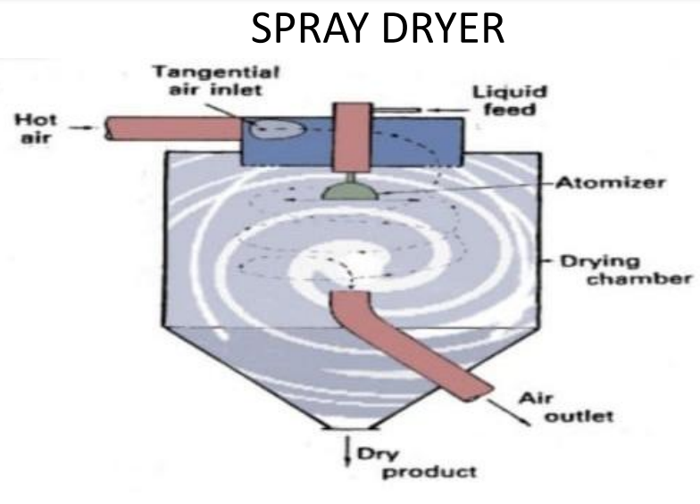

Slide 25
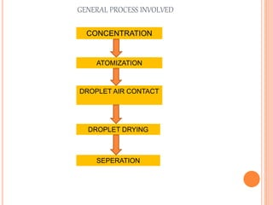

Slide 26
Freeze drying
Freeze drying is also known as lyophilization
lyophilization is carried out using a simple principle of physics, sublimation
Principle
The entire process is performed at a low temperature and pressure by applying vacuum, hence it is suited for drying of thermal sensitive compounds

Slide 27
Procedure
. First food products are freezed
. After freezing, the product is placed under vacuum.
• Heat is applied to frozen product to accelerate sublimation
Characteristics of freeze dried product
• Sufficient strength
• Uniform color
• Sufficiently dry
• Sufficiently porous
• Sterile
• Free of pyrogens and particulates
• Chemically stable
Preservation of Nutrients in food:

Slide 28
Chemical method of food preservation
Using chemical preservatives
1. Benzoic acid (including benzoates) Sodium benzoate is a salt of benzoic acid and is used in preservation of coloured fruit juices
2. Sulphur dioxide (including sulphites): Potassium meta-bi­-sulphite is used as a source of sulphur dioxide when it is added to the juice. When used in fruits with deep colours like blue grapes, jamun, watermelon it bleaches the colour and hence in such cases benzoic acid is desirable.

Slide 29
3. Organic acids and their salts:
Foods can be preserved by adding lactic, acetic, propionic, citric acids and their salts.
Nitrates and nitrite compounds are used to preserve meat and fish products.
It gives desirable colour, flavour
Discourages the growth of microorganisms.
It also prevents toxin formation by the microorganisms in food.
Salting and Pickling
Salting
Salt is added to enhance taste
Extend shelf life in foods such as butter, cheese, vegetables, bread and meat products.
Dry salting is used for meat, mango, amla and fish.

Slide 30
Pickling
It is also an ancient preservation technique.
The preservation of fruits and vegetables using common salt, vinegar, oil and spices are referred to as pickling.
The layer of oil that floats on the top of pickles prevents the entry and growth of microorganisms­ like moulds and yeast. Spices like turmeric, pepper, chilli ­powder retard the growth of ­bacteria.
Vinegar provides an unfavourable acidic environment for microbial growth.
The salt added absorbs water and prevents the growth of micro-organisms.

Slide 31
Fermentation: fermentation is a process in which an microorganism converts a carbohydrate, such as starch or sugar, into an alcohol or an acid.
Advantages
Fermentation preserves food promotes the growth of beneficial microorganisms, such as probiotics (fermented probiotic foods — such as yogurt), which can contribute to gut health and enhance overall food safety.

Slide 32
Batch vs. Continuous Processing
Food is processed in either
batches
or a continuous system.
Generally, batch systems are used to produce small quantities of food,
whereas larger volumes are required for continuous systems.

Slide 33
Advantages of Batch Processing | Advantages of Continuous Processing
Greater flexibility to change product formulation and rates | Lower operation and labour costs
Lower equipment costs | Less floor space required
Easier operation and control | Greater product uniformity

